Slide 1
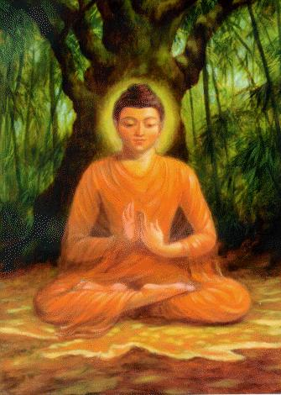
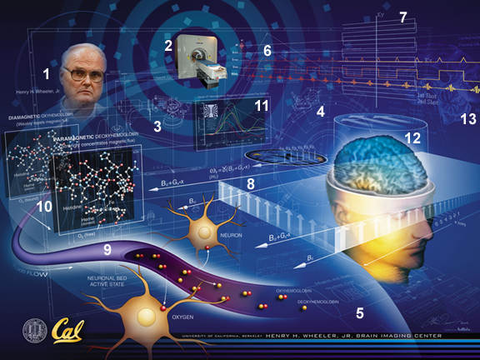
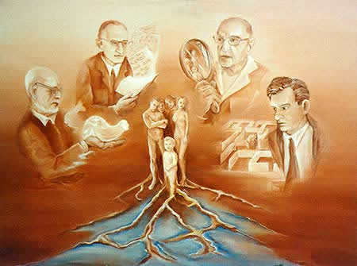
THÉRAPIE FONDÉE SUR LA COMPASSION
Psychologie
Cognitive
& évolutionniste
Psychologie Bouddhiste
Neurosciences
Notes:
Elle s’enracine dans une approche des processus psychologiques centrée sur la psychologie évolutionniste et les neurosciences

Slide 2
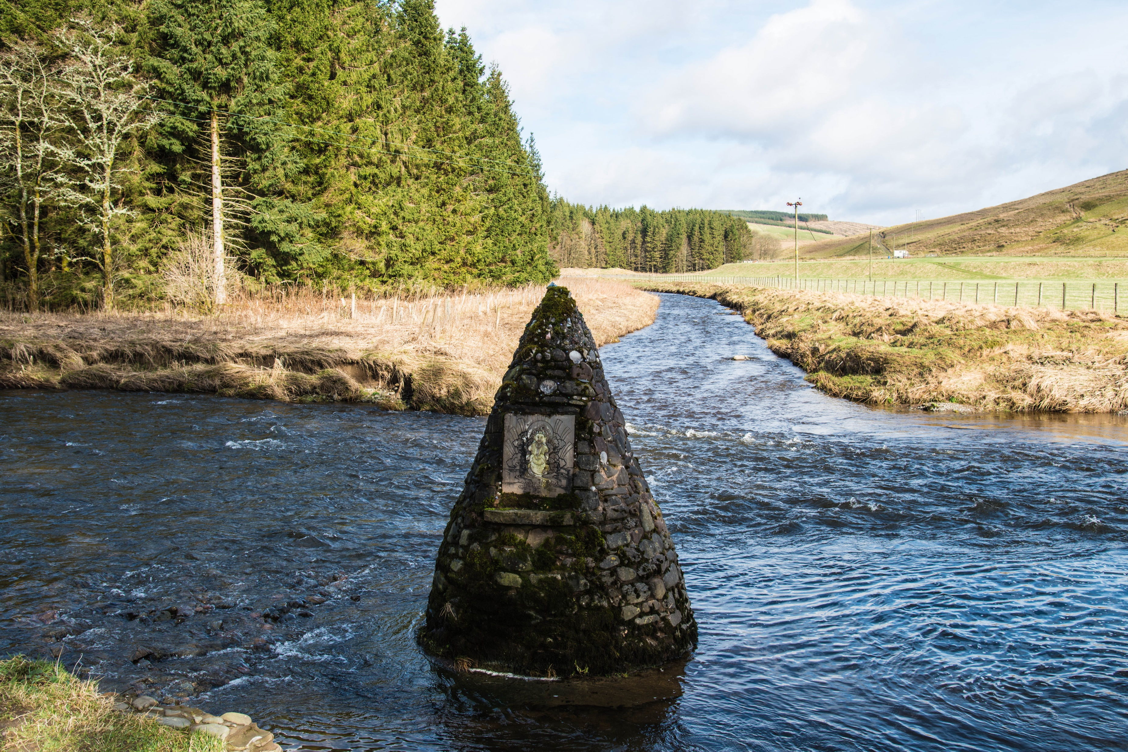
Notes:
In February 2014 while we were participating in a teaching skills Retreat in Samye Ling the Buddhist monastery in Scotland
We we re given the privilege to witness with our own eyes the metaphorical merging of CFT and Mindfulness
This is probably one of the few places in the world where two rivers flow together right angled!
We can notice that when two rivers meet there may be turbulence!

Slide 3
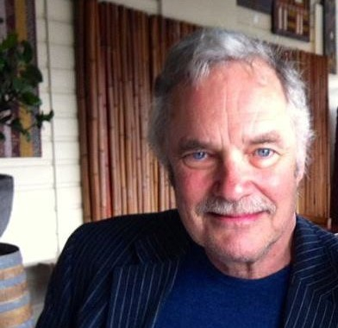
Paul Gilbert, 2017
“
Une sensibilité à sa propre souffrance et à celle des autres avec un engagement profond* à essayer de la soulager et de la prévenir…

Slide 4
Trois systèmes de régulation des émotions (les trois cercles)
Instincts, excitation, vitalité
Satisfaction, sécurité, connexion
Centré sur les conduites
satisfaire les besoins, poursuivre,
accomplir
Activant
Centré sur
l’apaisement,
l’affiliation,
la sécurité
et la gentillesse
Apaisant
Centré sur
les menaces
Recherche de
protection
et sureté
Activant / Inhibant
Depue R.A. and
Morrone-Strupinsky J.V.
Behavioural and Brain Sc, 2005,
28: 313-395
Colère, anxiété, dégoût

Slide 5
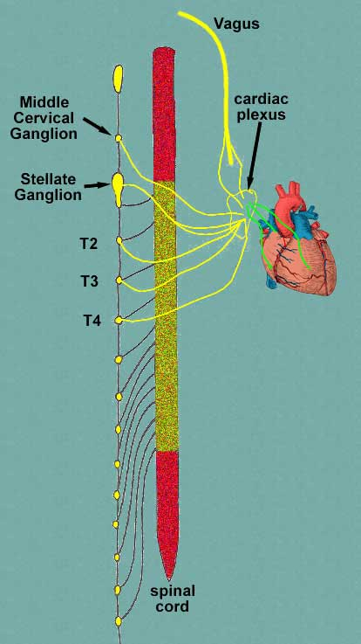
Innervation cardiaque par le système Parasympathique
Ralentit le rythme cardiaque
Innervation cardiaque par le système sympathique :
Accélère le rythme cardiaque
Notes:
5
5

Slide 6
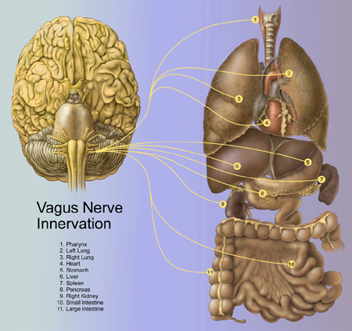
Sécurité: implication du système nerveux parasympathique (nerf vagal)
Le parasympathique diminue le rythme cardiaque à chaque expiration
Associé à l’affiliation, au fait de soigner, d’être amical et d’une manière générale aux émotions positives
Lié au sentiment de sécurité
Notes:
Emanating from the brainstem, the 10th cranial nerve, is the Vagus. The Vagus is affectionately referred to as the ‘wandering’ nerve – because it projects to so many parts of the body and is involved in a range of functions, as depicted by the yellow lines here. The Vagus nerve functions I would like to focus on – which have to do with mindfulness at the 2 and 3 levels, are it’s influence on heart rate, and it’s role in affiliative states. The yellow line that terminates on a number 4 – represents a shockingly important process – the Vagus nerve imparting parasympathetic influence on heart rate – that is – slowing the heart down. Without vagal input, your heart would beat unsustainably fast to your mortal demise. There is a rich scientific literature on this process, measuring the ratio of heart rate during inhale (driven by sympathetic input) and that during exhale (vagal input) – yielding a measure called Vagal Tone. Vagal Tone, it turns out, is predictive of a host of benefits: calm behavioral states, being better at relating to emotional experiences in a healthy way (a property often called resilience), generally experiencing more positive than negative emotional states, lower blood pressure, and more. Mindfulness practice has been shown to strengthen vagal tone (Ditto, McGill, Annals of Behavioral Medicine). That said, thinking about mindfulness & compassion, the capacity of vagal tone to adapt to environmental changes (e.g., physiological, cognitive or psychological challenges) defined as vagal flexibility, e.g. high vagal flexibility allows sympathetic activity to occur and limits efficiently the stress period to the stressors presence may be the measure of importance. Studies have shown that vagal recovery may be more strongly associated with mindfulness than vagal tone alone.
The second function I’d like to touch upon comes from a pioneering scientist named Steve Porges, author of the PolyVagal theory – which suggest that a primary funciton of the Vagus nerve is to support affiliation and the formation of social ties that lead to long term relationships. Coming from a functional biological perspective, Porges suggests that the Vagus nerve’s visceral input to the brain, support of vocal fluctuations and parasympathetic influence drives people to approach others for cooperative gain, to communicate in close proximity, and develop dependencies. An entire field has emerged from Porges’s – including work by Dacher, Stepahie Brown, and others. A key part of the story here is that vagal influence is exxentially silenced by fear, vigilance to threat, anxiety, etc…
An emerging science on the study of MindWandering – that is – absentmindedly thinking about what’s not happening right now – is deleterious to happiness – engages systems that typically track thoughts about the self: what happened, what might happen, and why they might not like me…a style of reflexive thinking for which mindfulness is pointedly an antidote.
6

Slide 7
La montée du diaphragme stimule le parasympathique
Les terminaisons du nerf sympathique sécrètent
de la noradrénaline
qui activent les récepteurs
adrénergiques
qui stimule l’activité
cardiaque, mais
Inhibe l’activité gastro-intestinale
Les terminaisons
du nerf vagal
sécrètent de
l’acétylcholine qui
active
les récepteurs
cholinergiques
inhibant
l’activité
cardiaque, mais
stimulant l’activité
gastro-
Intestinale.
La baisse du diaphragme stimule le sympathique

Slide 8
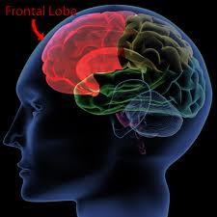
le cerveau nouveau: cortex frontal et système parasympathique
Flexibilité
Attention pleinement consciente
Contrôle de l’attention
Pensée réflexive
Empathie
Savoir ne pas sur-réagir aux émotions

Slide 9
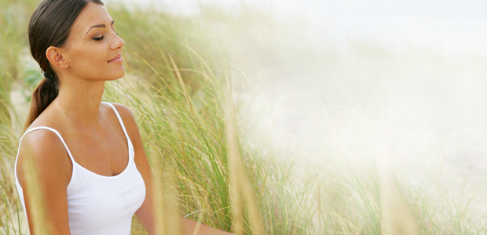
Le Rythme Respiratoire Apaisant (RRA)
Soothing Breathing Rhythm (SBR)
Notes:
9
Faites la démonstration “position instable vs stable” et contextualisez comme trouvez et centre interne - un point de stabilité and contextualise as find
Approfondir et ralentir la respiration – 5-6 respirations par minute
Se focaliser sur l’expiration et la sensation de ralentissement
Porter l’attention sur les sensations corporelles légèrement plus lourdes
Sentiment d’enracinement, de solidité
Trouver le point de calme intérieur (ce n’est pas la même chose que la relaxation!)
Démontre la valeur de l’expression faciale - 15 sec neutre 15 second sourire
Le rythme respiratoire apaisant combine la focalisation sur la posture et le corps

